Slide 1
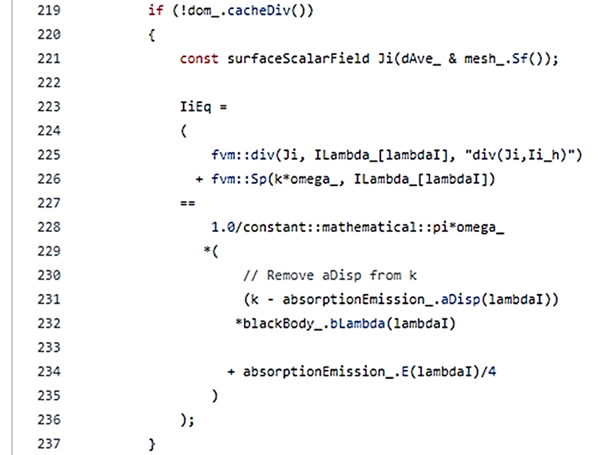
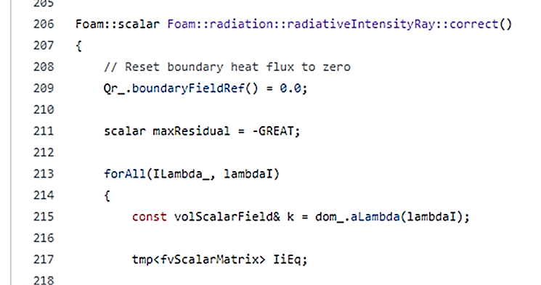
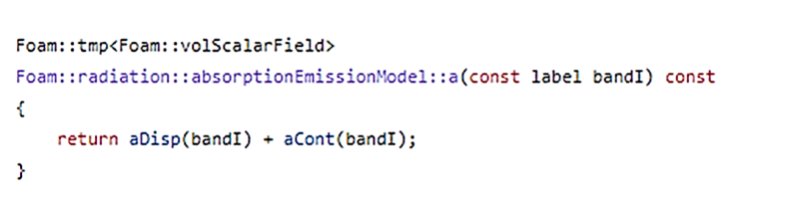
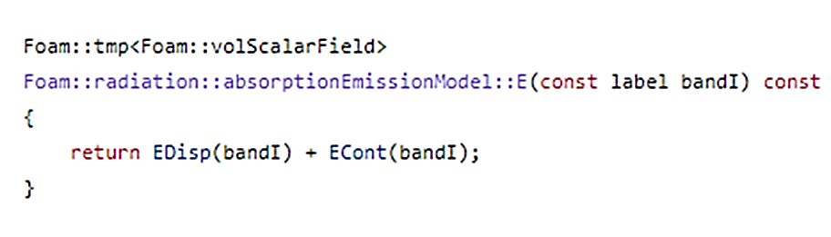

RTE fvDOM (radiativeIntensityRay.C)
omega = solid angle (steradians)
bLambda = $σT^{4}$
aLambda = aCont + aDisp (total absorption coefficient in units of 1/m)
absorptionEmissionModel.C
absorptionEmissionModel.C

Slide 2

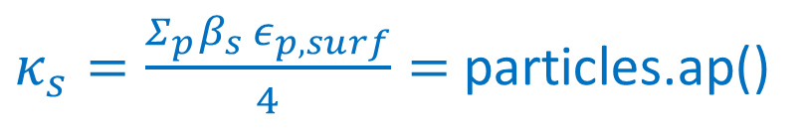

Radiation Transfer Equation
$$\frac{d}{ds}\left(\left(1−β_{s}\right)I\right)=\left(1−β_{s}\right)κ_{g} \left(\frac{σ{\tilde{T}}^{4}}{π}−I\right)+\frac{Σ_{p}β_{s} ε_{p,surf}}{4} \left(\frac{σT_{p,surf}^{4}}{π}−I\right)$$
$κ_{s}=\frac{Σ_{p}β_{s} ε_{p,surf}}{4}=$ particles.ap()
$$\frac{d}{ds}\left(\left(1−β_{s}\right)I\right)=−\left(\left(1−β_{s}\right)κ_{g}+κ_{s}\right)I+\left(1−β_{s}\right)κ_{g}\frac{σ{\tilde{T}}^{4}}{π}+κ_{s}\frac{σT_{p,surf}^{4}}{π}$$
$$=−\left(\left(1−β_{s}\right)κ_{g}+κ_{s}\right)I+\left(1−β_{s}\right)κ_{g}\frac{σ{\tilde{T}}^{4}}{π}+\frac{1}{4π}(E_{g}+E_{s})$$
$$E_{g}=ECont=χ_{rad} {\dot{q}}_{rad}^{′′′}$$
$$E_{s}=EDisp=4 κ_{s} σ{ T}_{p,surf}^{4}$$

Slide 3
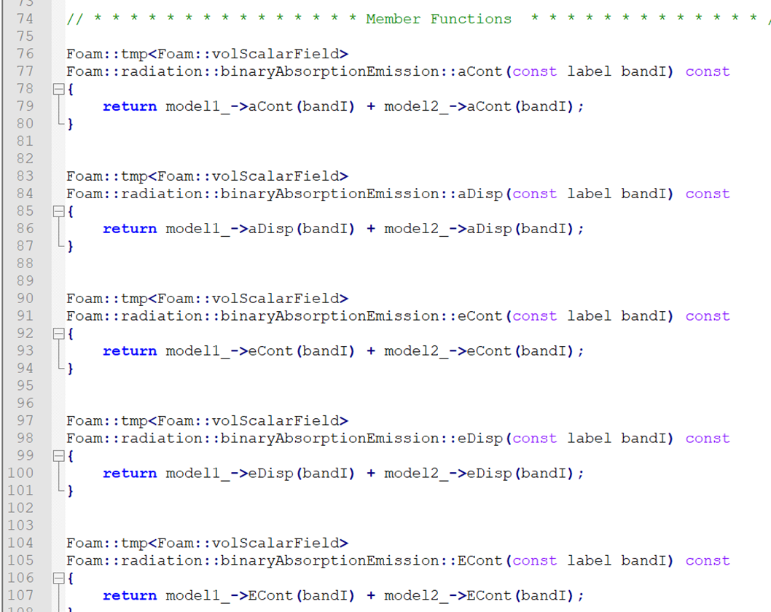
Binary absorption emission model:
adds and returns the absorption and emission coefficients and terms from two distinct models
binaryAbsorptionEmission.C

Slide 4
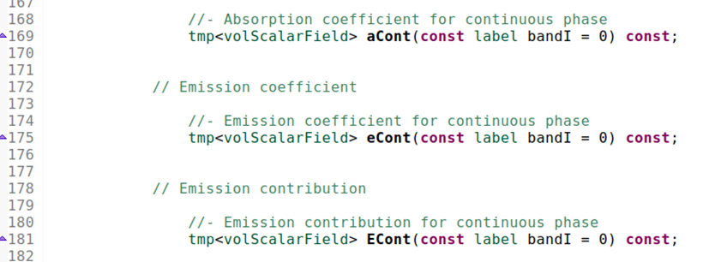
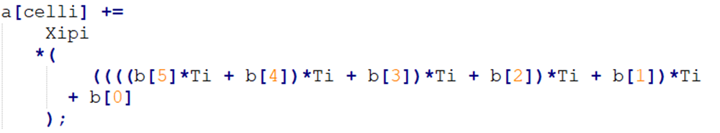
greyMeanAbsorptionEmission.C
$$aCont$$
$$eCont$$
$$ECont$$

Slide 5
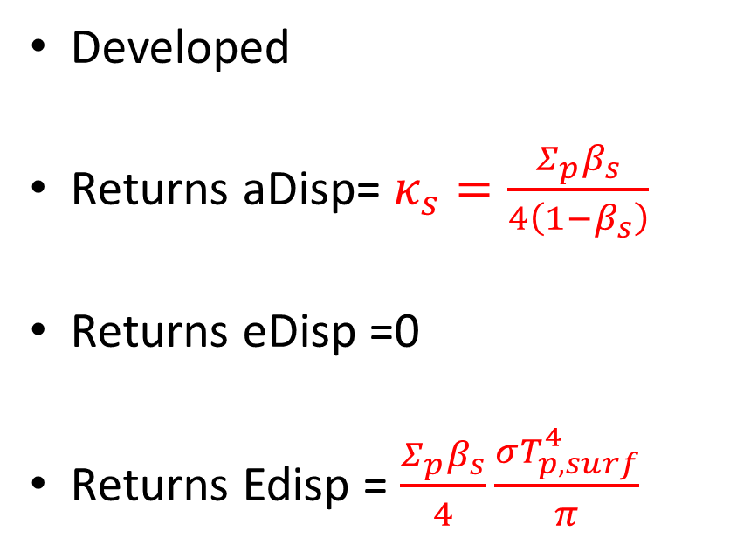
biomassCloudAbsorptionEmission.C
Developed
Returns aDisp= $κ_{s}=\frac{Σ_{p}β_{s}}{4\left(1−β_{s}\right)}$
Returns eDisp =0
Returns Edisp = $\frac{Σ_{p}β_{s}}{4}\frac{σT_{p,surf}^{4}}{π}$
To be used in the RTE Only!!

Slide 6
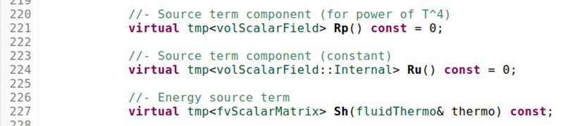
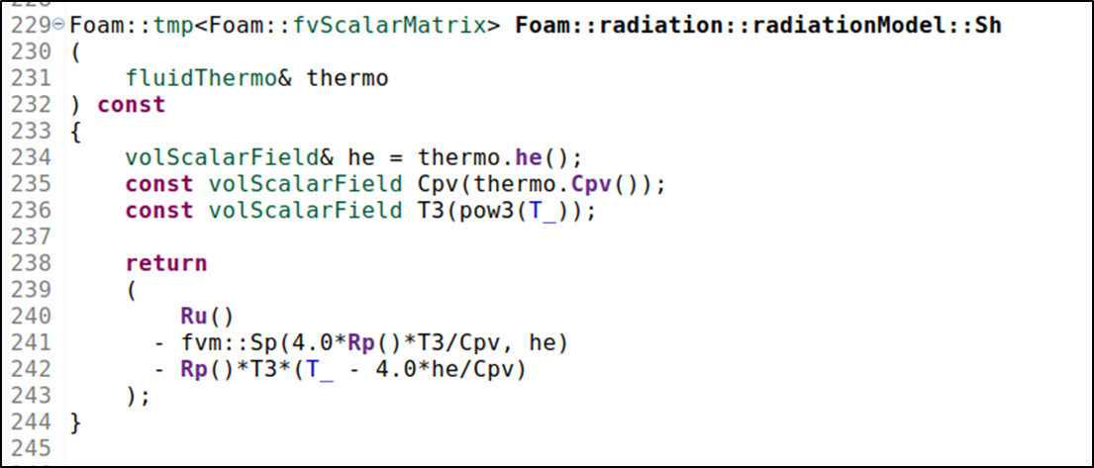

Energy Equation Source Term $radiation.Sh(thermo)$
$${\dot{q}}_{rad}^{′′′}+{\dot{h}}_{th}^{′′′}=\left(1−β_{s}\right) κ_{g}(\int_{4π}{IdΩ}−4σ{\tilde{T}}^{4})−\left(Σ_{p}β_{s}\right)×h\left(T−T_{p,surf}\right)$$
radiation.Sh(thermo)
particles.Qconv()
radiationModel.H
Rp and Ru are used to calculate the radiation source term in the energy equation only
radiationModel.C
$$Sh≅ Ru − Rp T^{4}$$

Slide 7
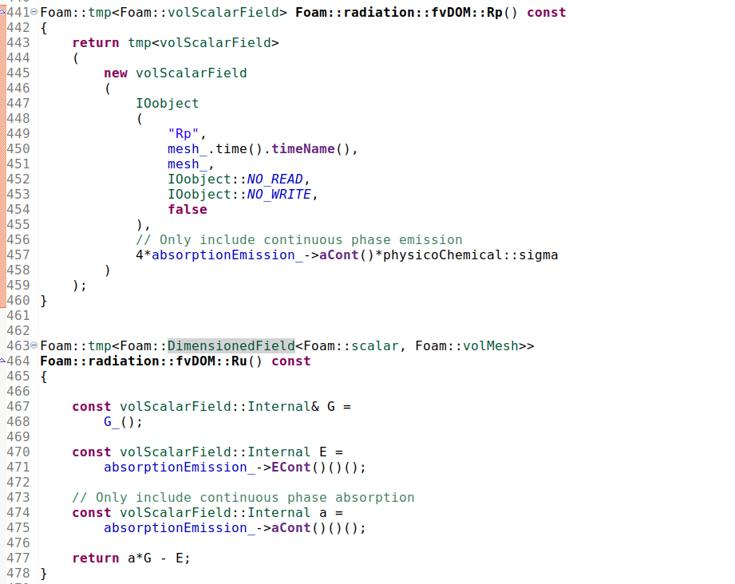
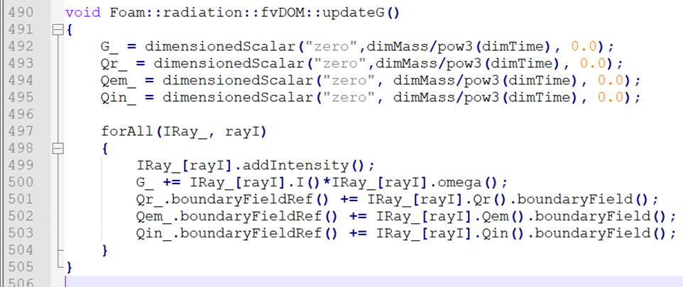


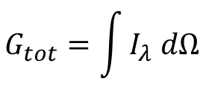



Energy Equation Source Term $radiation.Sh(thermo)$
FvDOM.C
$$Rp ≈4 a σ$$
$$G_{tot}=\int{I_{λ} dΩ}$$
Absorption coef. for continuous phase
$$Sh≅ Ru − Rp T^{4}$$
$=aCont G_{tot}−ECont−4 aCont σ T^{4}$
Emission contribution for continuous phase
$$aCont≅κ_{g}$$
$ECont≅χ_{rad}HRR$ when aCont=0
$$Ru ≈a G −E$$

